Slide 1



AWIS Book Club Discussion
“Mommy, Can Boys Also Be Doctors?”
June 3rd, 2026

Slide 2
MASS AWIS
Mission:
AWIS is a national advocacy organization championing the interests of women in science, technology, engineering, and mathematics across all disciplines and employment sectors. By breaking down barriers and creating opportunities, AWIS strives to ensure that women in these fields can achieve their full potential.

Slide 3
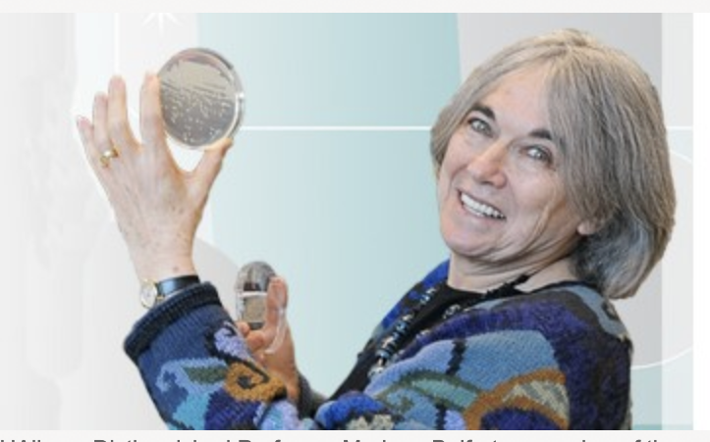
Dr. Marlene Belfort Biography
Distinguished Professor and Director of the Life Sciences Research Program at the University at Albany, SUNY
Born and educated in South Africa; earned undergraduate degree at the University of Cape Town
Received PhD in Molecular Biology from the University of California, Irvine
Completed postdoctoral research in Israel and the United States
Elected to the National Academy of Sciences and the American Academy of Arts and Sciences
Recipient of numerous honors recognizing scientific excellence and leadership in STEM
Received the 2025 AWIS Zenith Award Strong advocate for women and inclusion in science

Slide 4
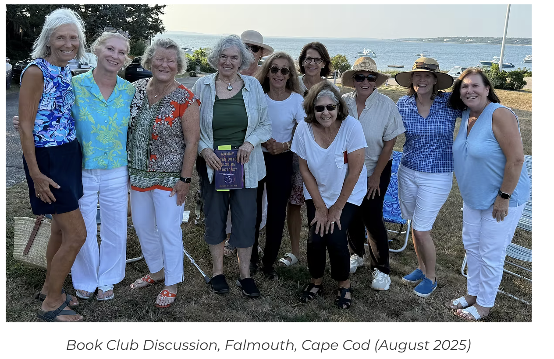
Mommy, can boys also be doctors?
A Message to Young Scientists and Other Humans (Launch Date: April 29, 2025)
The book explores walking the tightrope of balancing the personal and professional. It frankly discusses the human struggle to deal with discrimination, depression, and loss. And it celebrates the joy of living a rich, fulfilling life. Letting go is liberating!
​
First edition Spring 2025
235 pages
Lioncrest Publishing
​
Foreword by Paul Grondahl,
Director of NY State Writers Institute
​

Slide 5
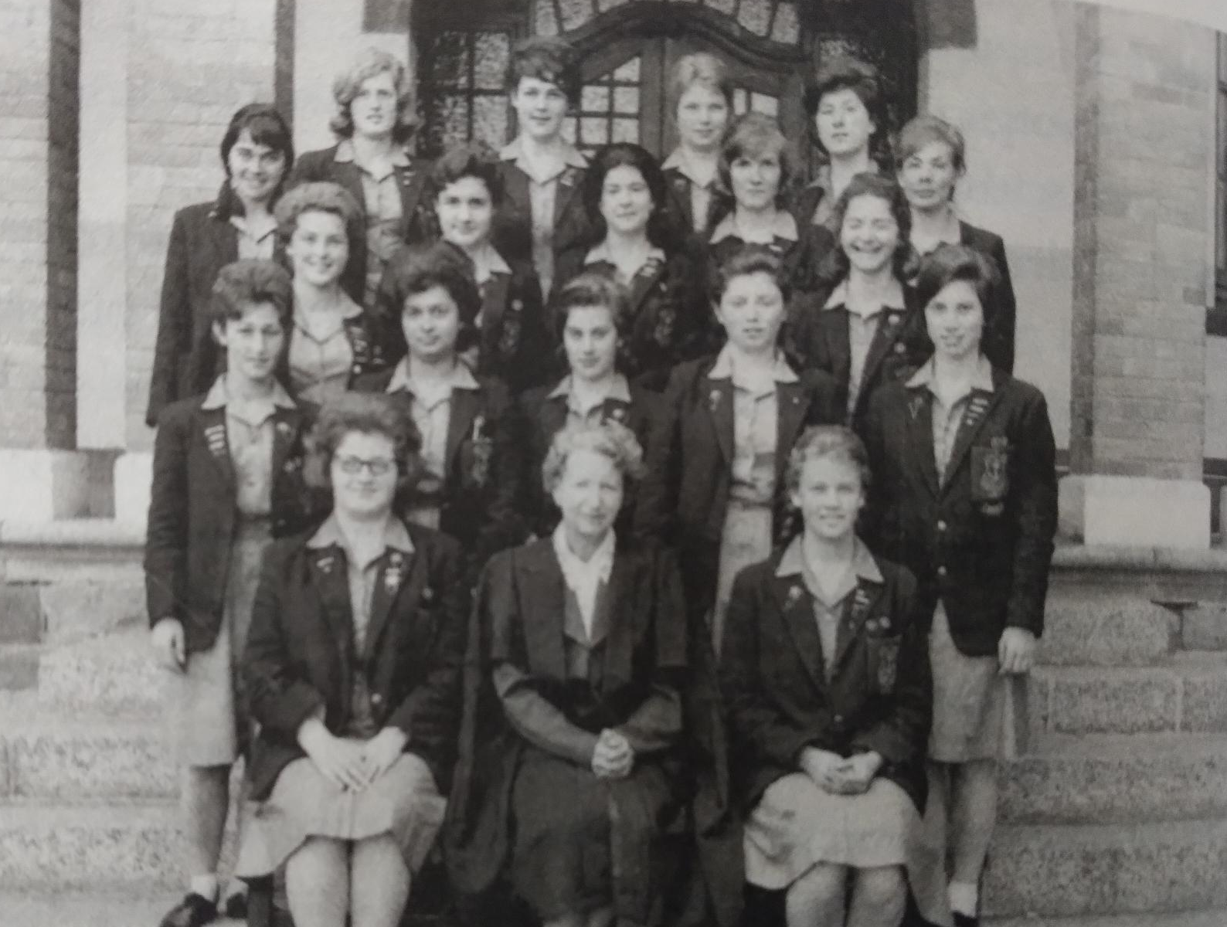
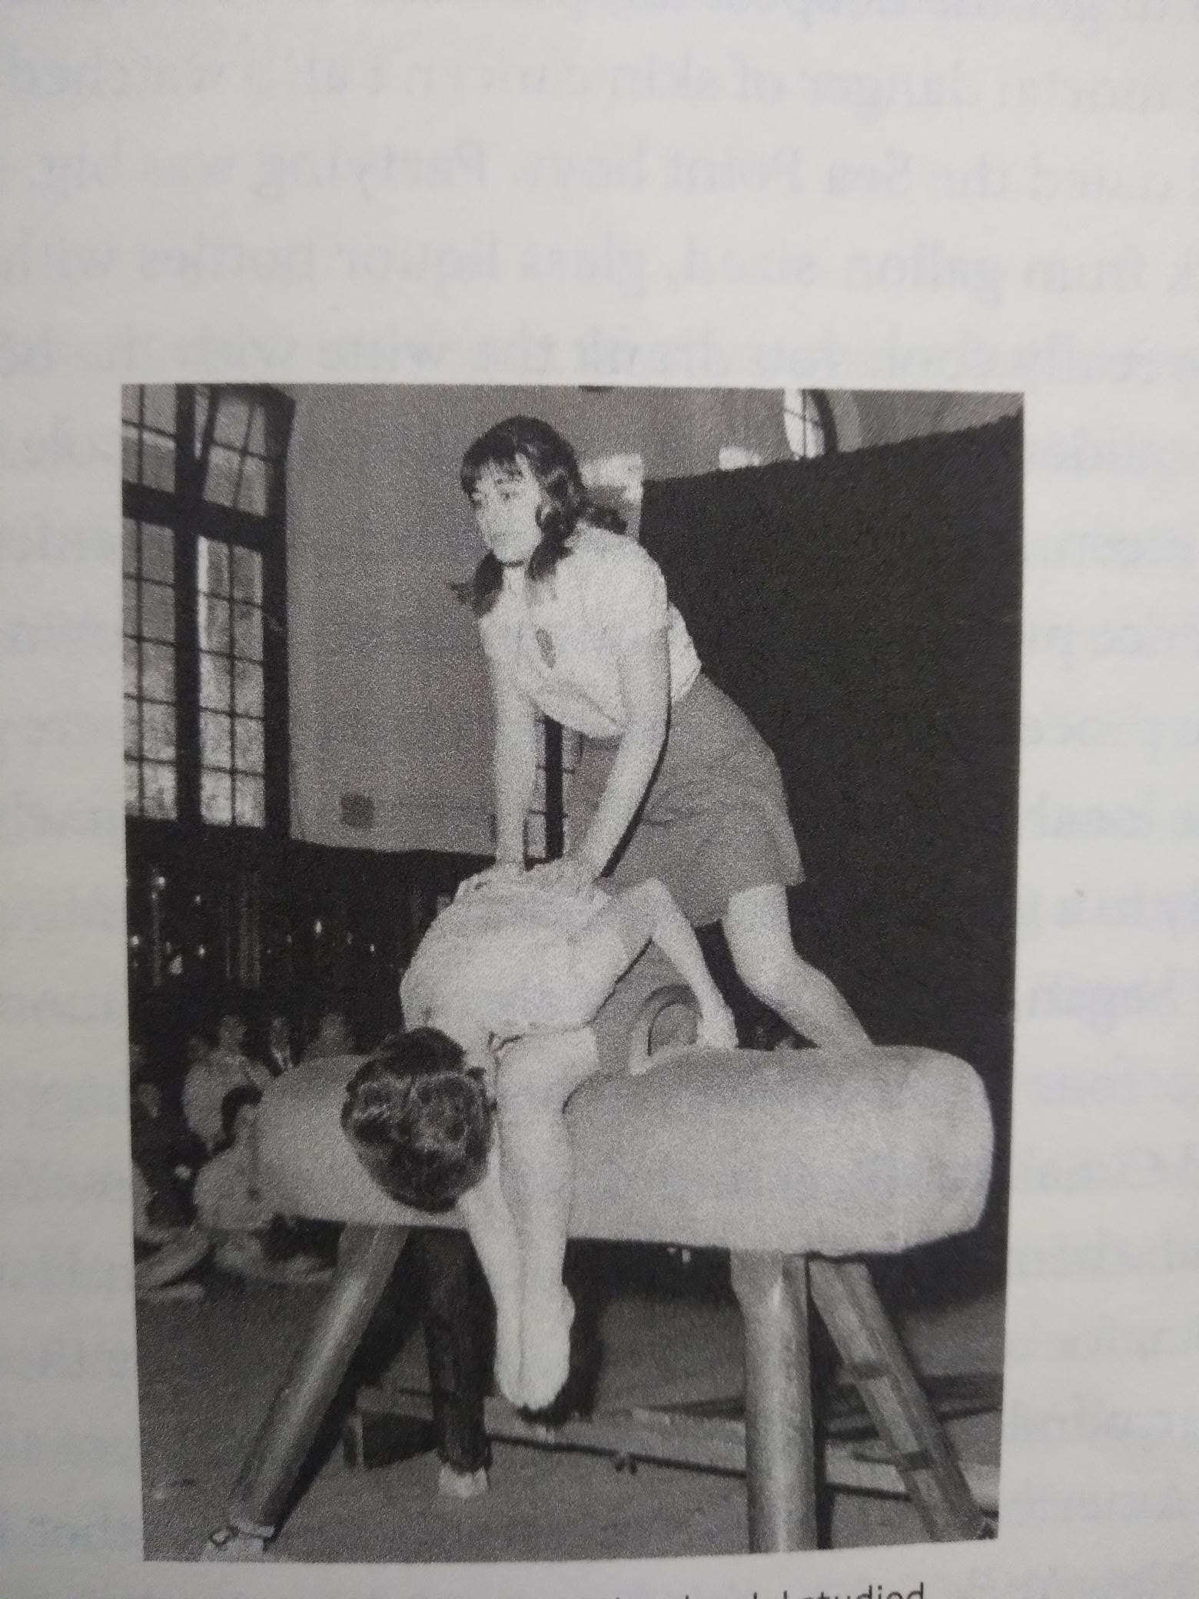
Good Hope High School

Slide 6
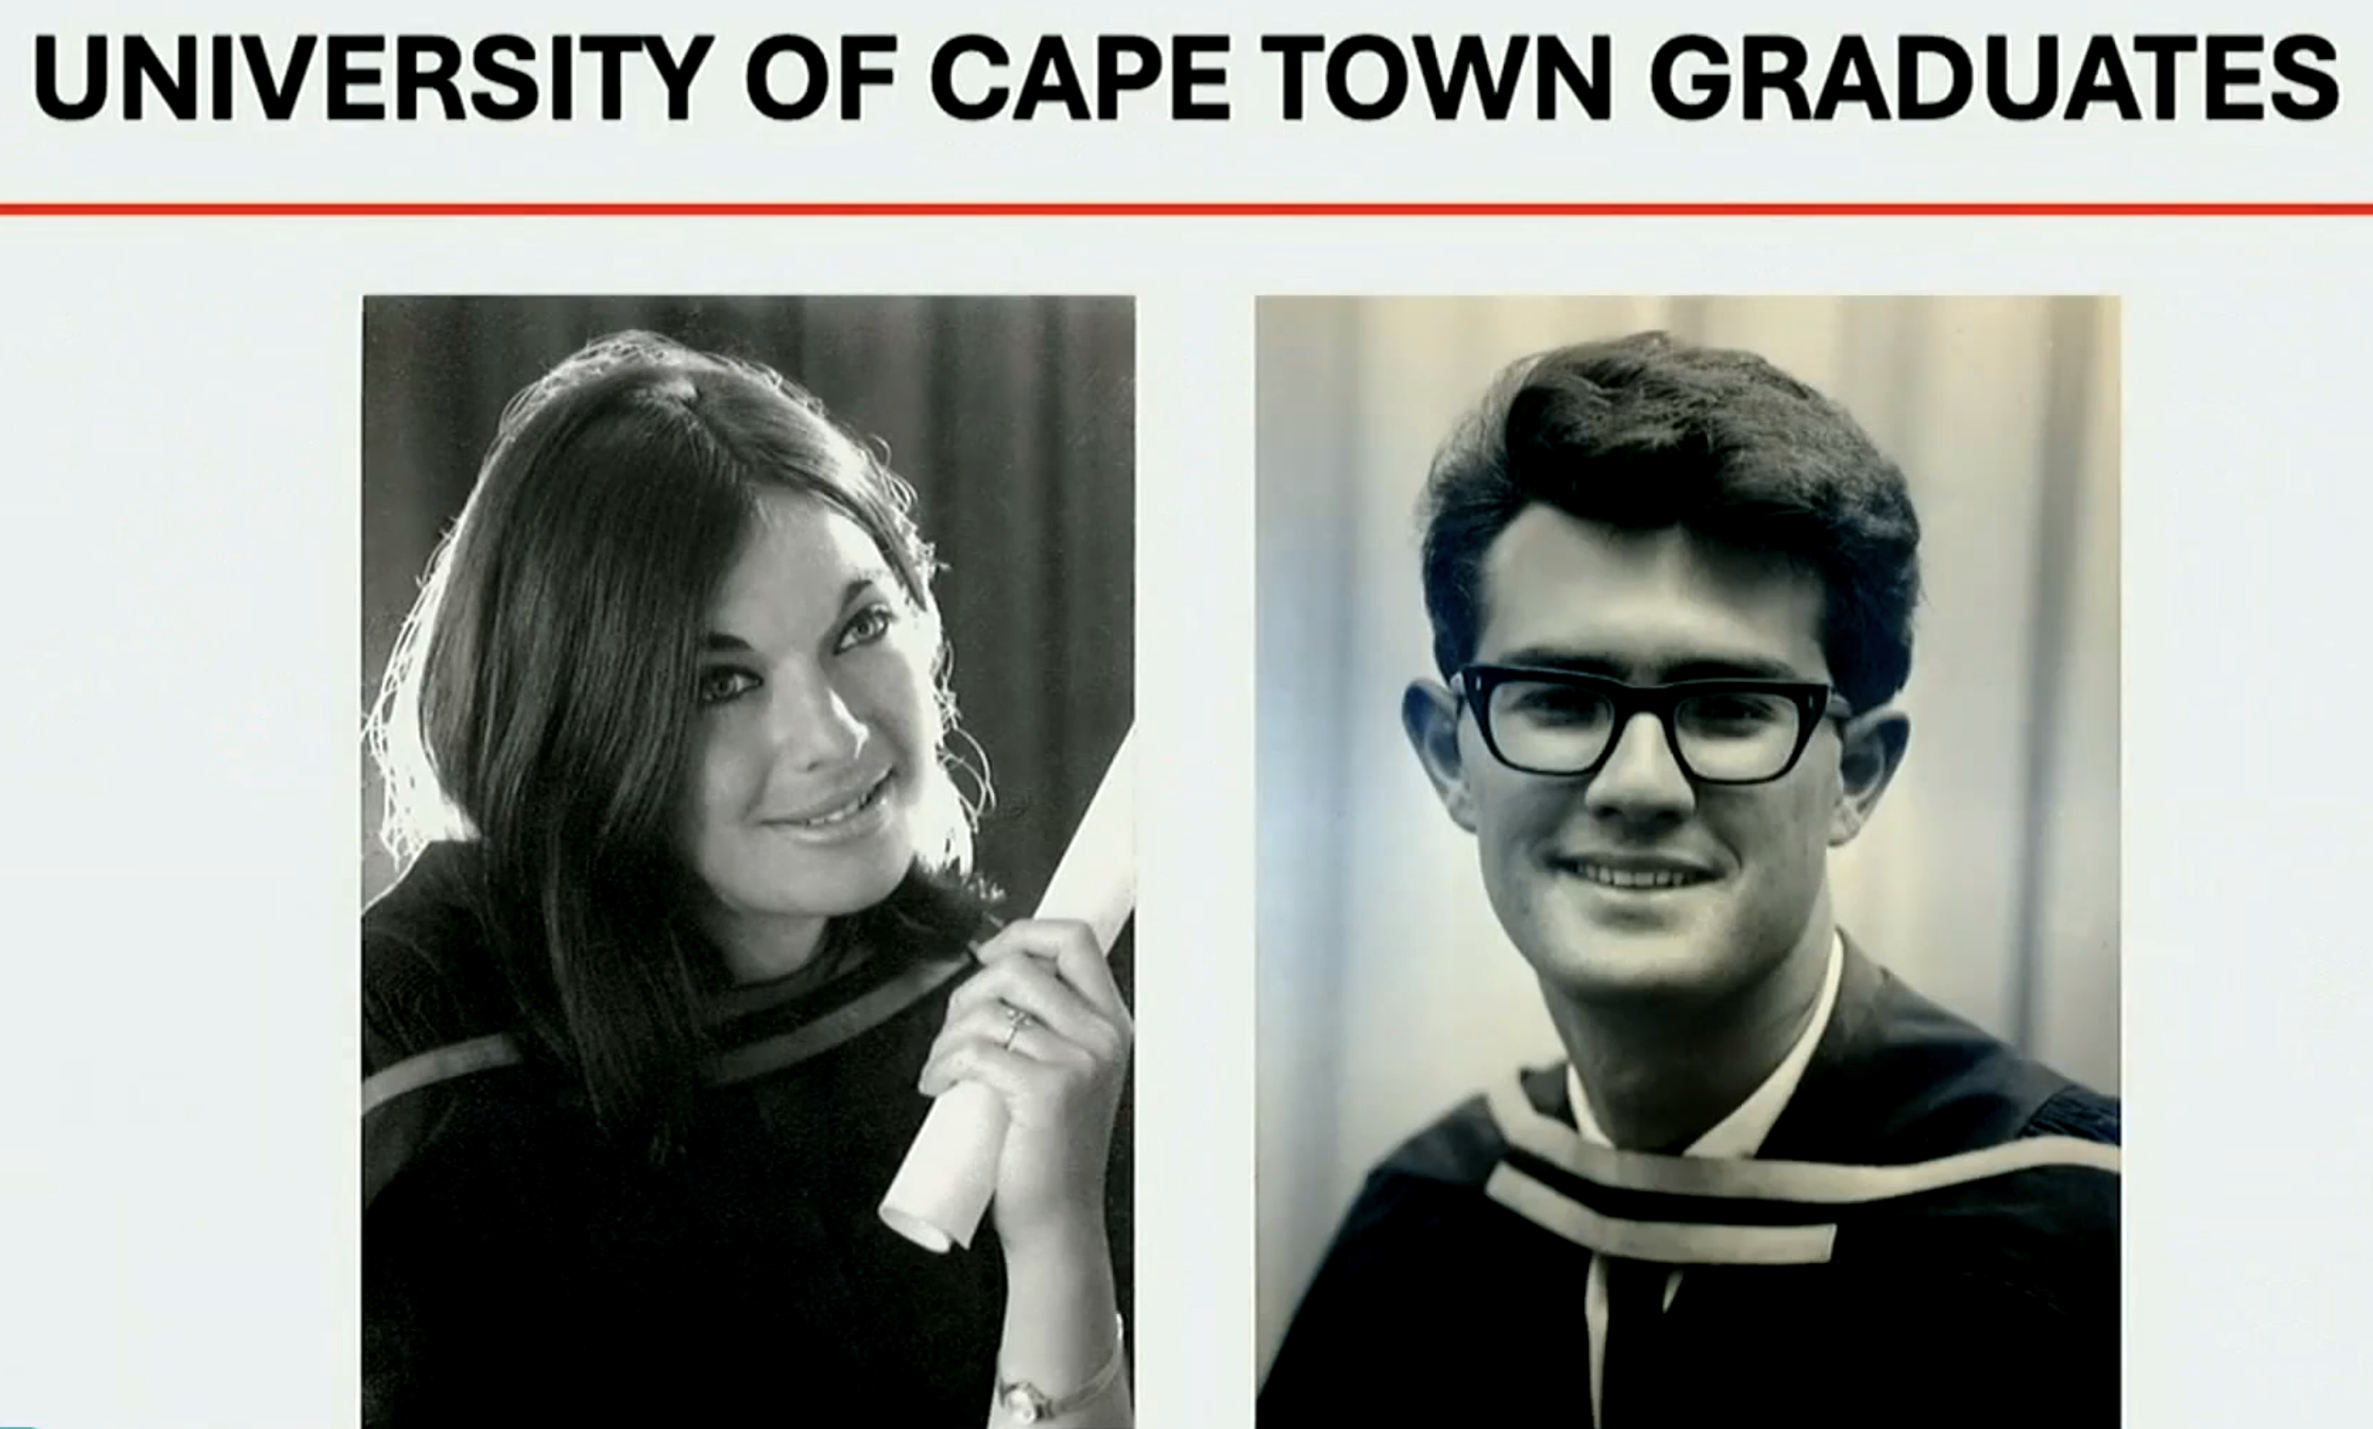
​
​

Slide 7
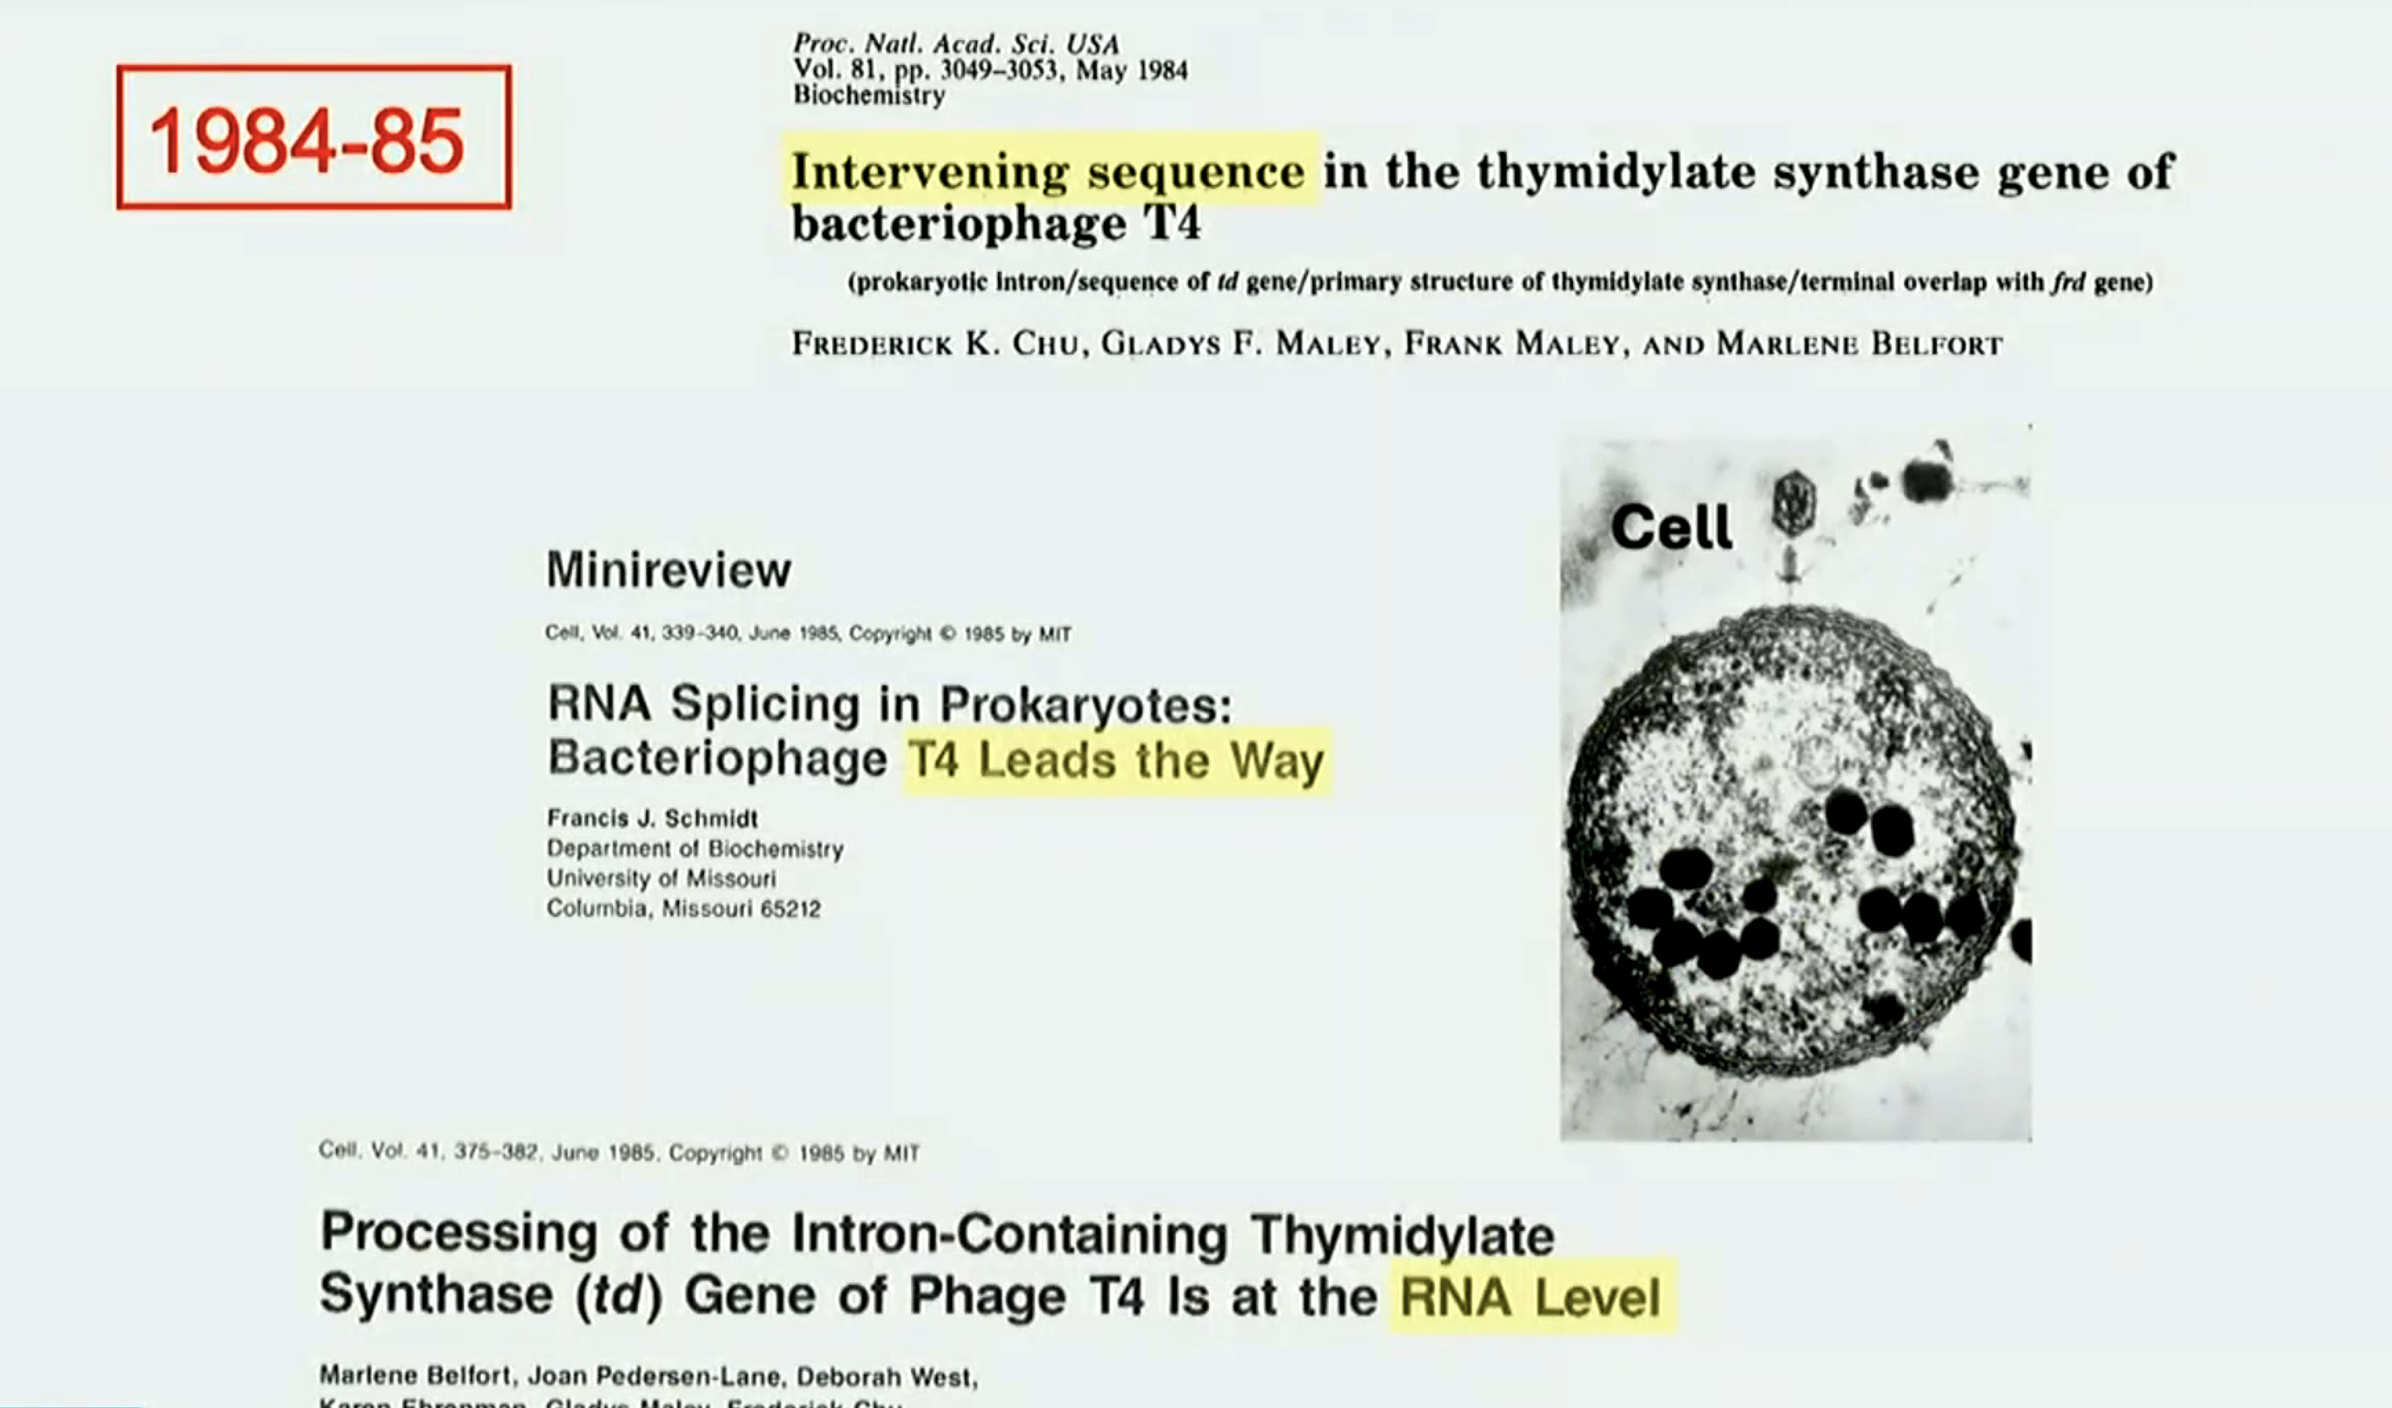

​
​

Slide 8
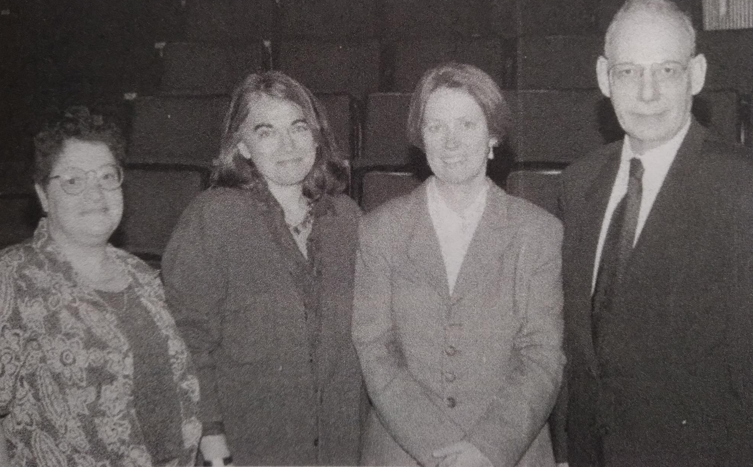
​
​
At Wadsworth Center

Slide 9
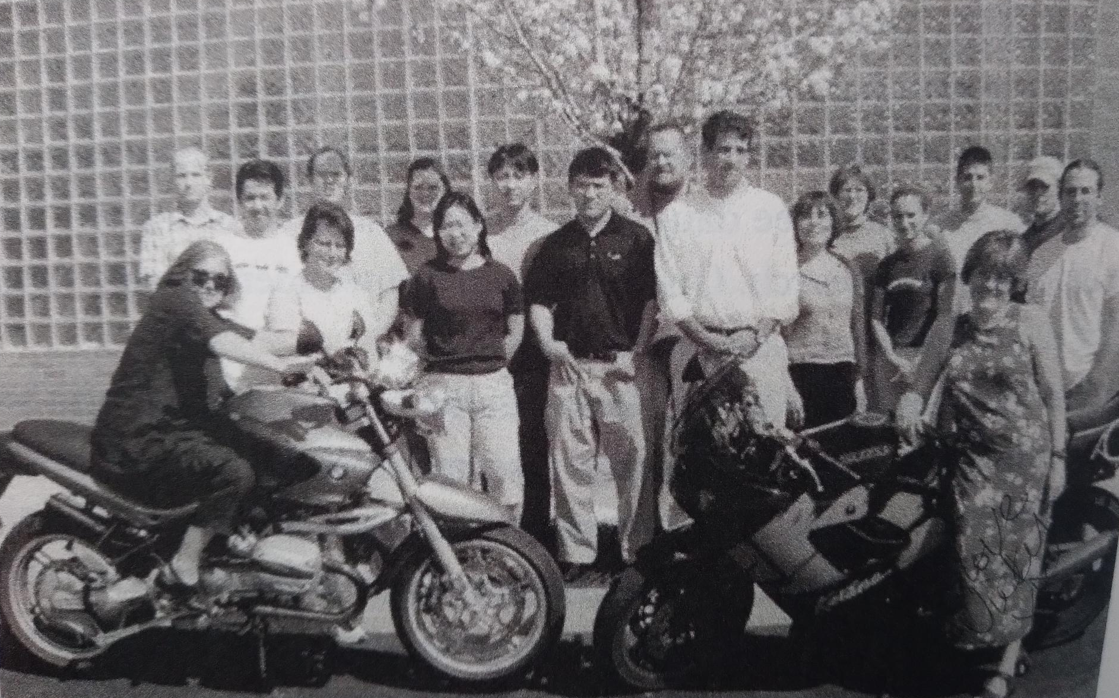
​
​
At Wadsworth center

Slide 10
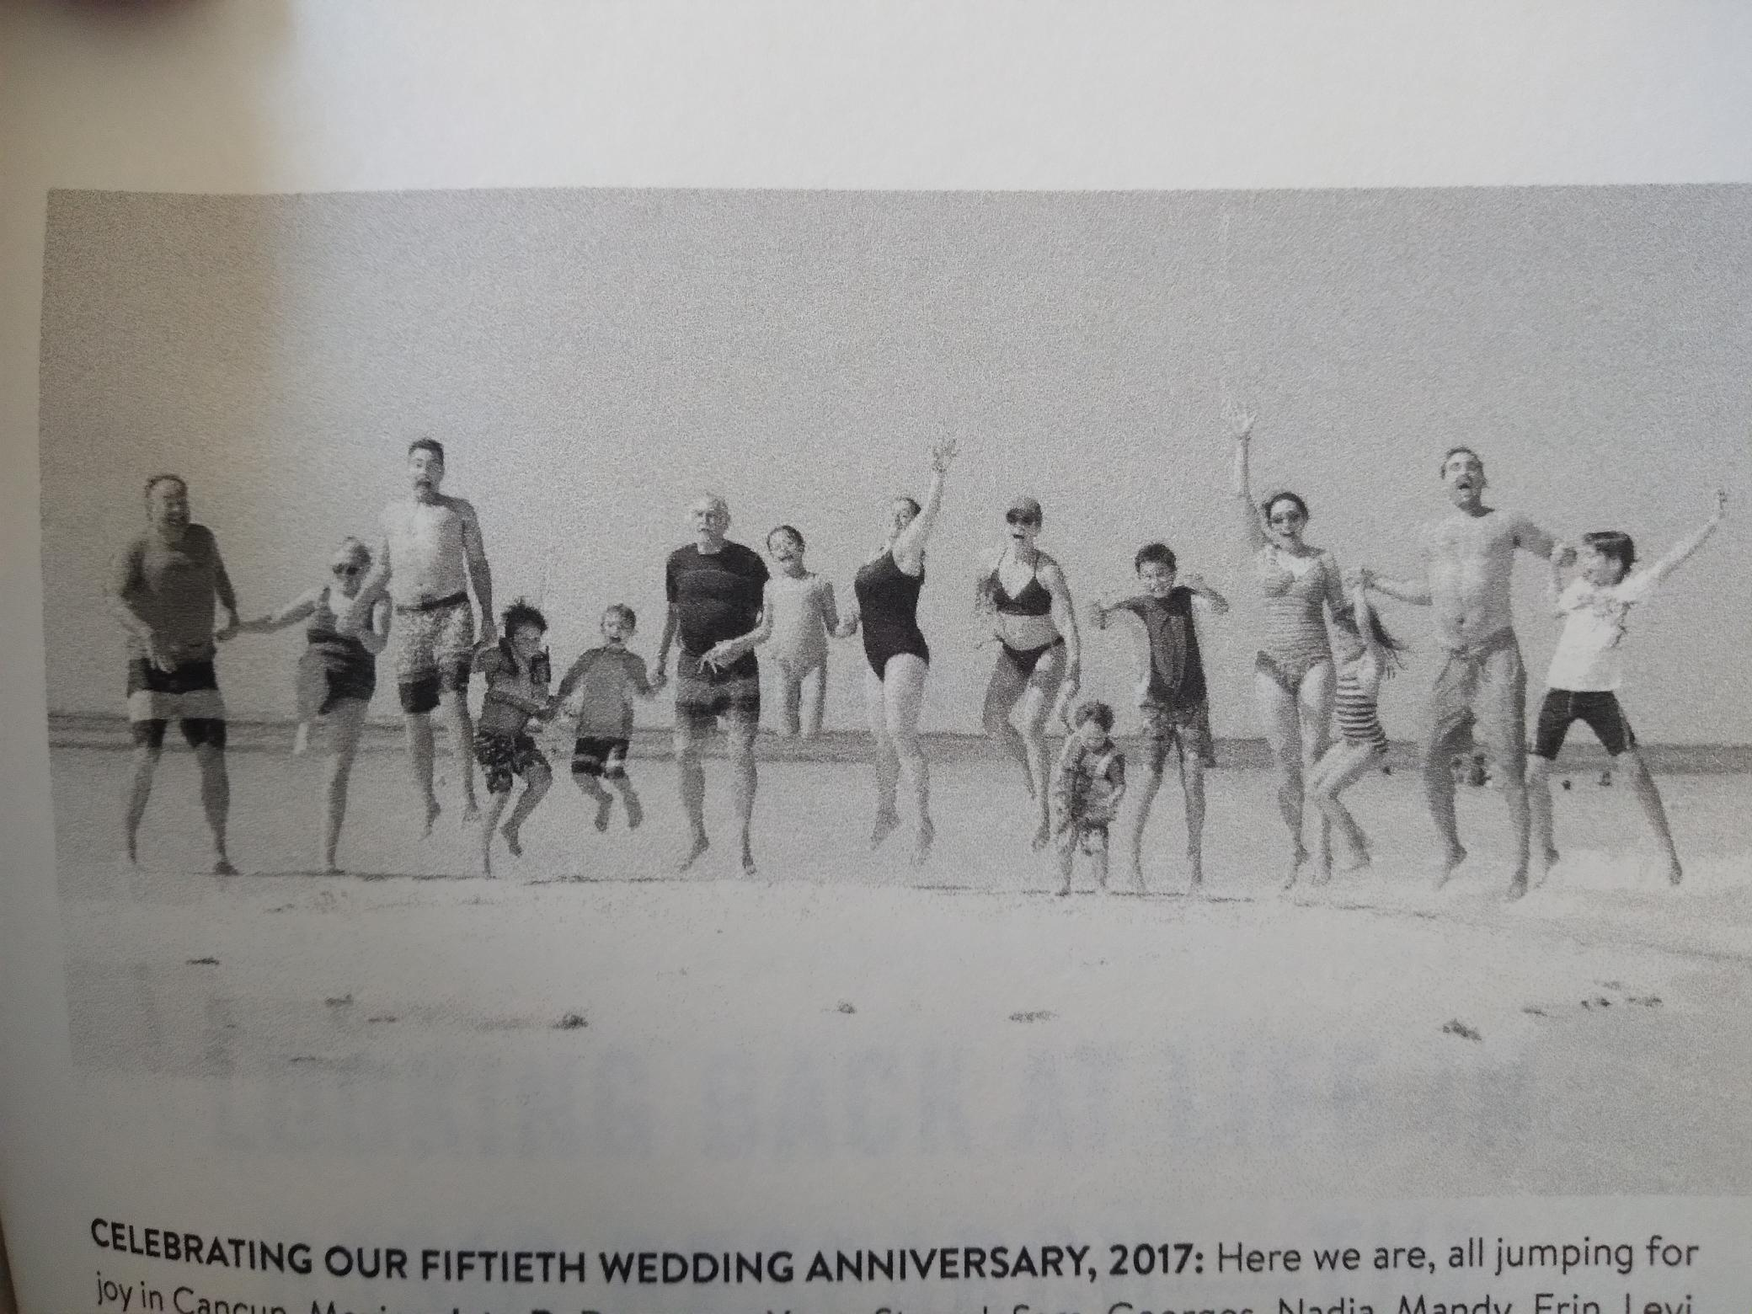
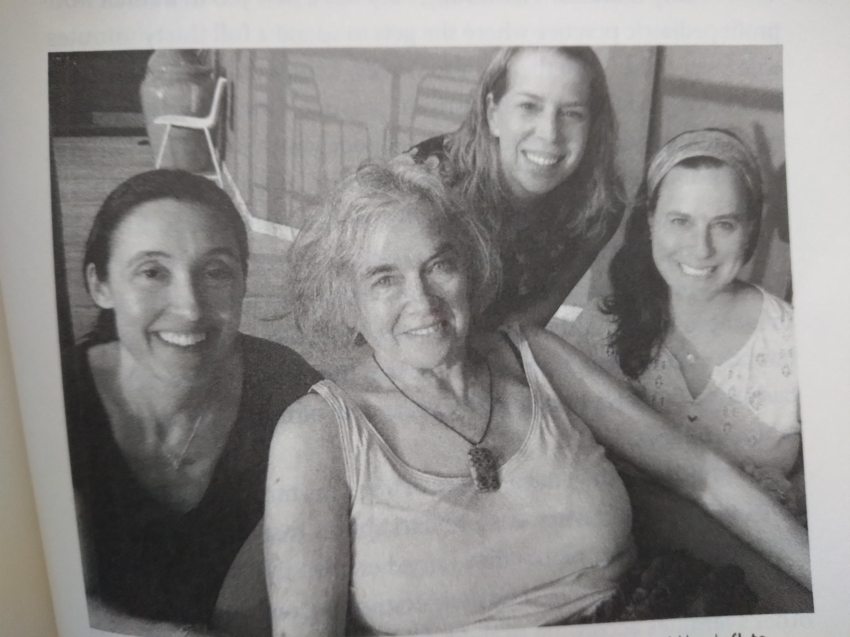
​
​
‘None of us is perfect, but each of us is good enough.
It’s good to walk toward those who can help us and who love us and to have the courage to walk away from those who don’t.

Slide 11
​
​
Thank you for joining us!

